Slide 1


Modern Theories & The Impact of Technology

Slide 2
Team members:
AREEBA ZAFAR

Slide 3

Introduction
Modern methodologies like Agile and DevOps have transformed software development.
These approaches emphasize speed, flexibility, and continuous improvement to keep pace with technological advancements.

Slide 4
Traditional Software Development
Waterfall Model:
Cons:
Linear and sequential process.
Requires phase completion before moving forward.
Inflexible to changes mid-project.
Long cycles cause delays in response to market demands.

Slide 5
Problems with Traditional Methods
Slow Adaptation: Cannot respond quickly to market changes.
Heavy Documentation: Time-consuming and often outdated.
Solution:
Shift to Agile for faster adaptation.
Implement DevOps for seamless deployment.

Slide 6

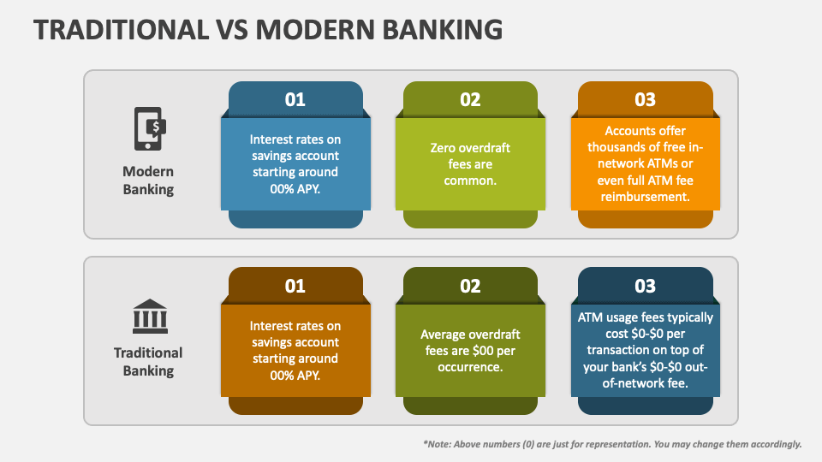
EXAMPLE: Traditional industries like banking struggle with slow innovation.

Slide 7
Research on Why We Need Modern Technologies
Key Findings:
Companies using Agile have 30% faster time-to-market (Harvard Business Review).
DevOps teams experience 60x fewer failures (Puppet Labs report).
Reason: Modern business needs require speed, adaptability, and continuous feedback.

Slide 8
Why We Need Agile & DevOps
Faster Time-to-Market: Essential in competitive environments.
Better Customer Satisfaction: Continuous feedback allows quicker fixes and feature releases.
More Efficient Processes: Automation reduces manual errors and streamlines delivery.

Slide 9
AGILE Methodology
PROS:
Cons:
Flexibility in adapting to change.
Continuous feedback loops.
Incremental delivery.
Can lack structure in larger teams.

Slide 10
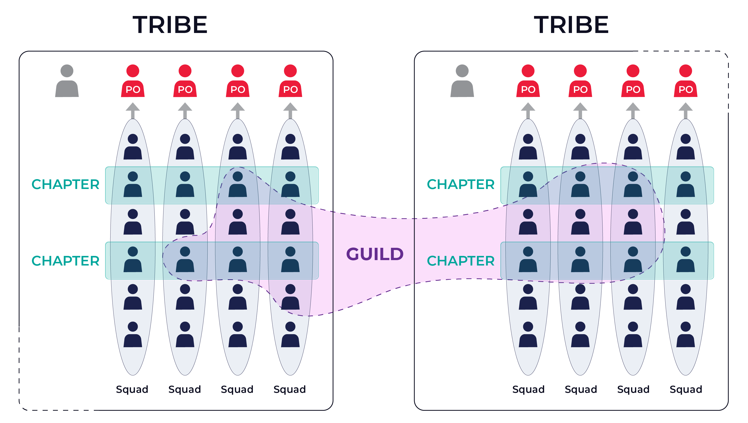
Real-Life Example: Spotify: Uses agile to quickly deliver updates based on user feedback.

Slide 11
DevOPS Methodology
PROS:
Cons:
Requires cultural changes in organizations.
Initial setup of automation can be costly and complex.
Faster releases through automation and continuous integration.
Improved collaboration between development and IT teams.
Continuous monitoring ensures more stable systems.

Slide 12

Real-Life Example: Amazon: DevOps allows rapid deployment thousands of times per day.

Slide 13
Challenges in Agile and DevOps Adoption
Agile Challenges:
Scaling issues in larger organizations.
Maintaining consistent communication across teams.
DevOps Challenges:
Requires extensive tooling and automation setup.
Can disrupt traditional roles in development and IT.

Slide 14

Solutions:
Implement cross-team
collaboration tools and
invest in training.

Slide 15
Agile vs Traditional Approach
Traditional:
Long development cycles with heavy documentation.
Agile:
Focuses on quick iterations and frequent feedback.

Slide 16
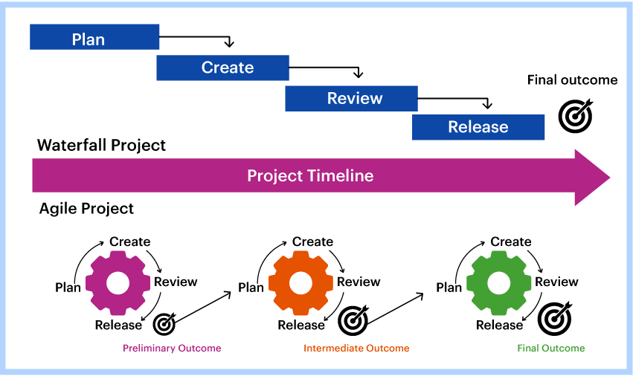
Diagram:
Traditional vs Agile Development Cycle.

Slide 17
dEVOPS vs Traditional IT
Traditional IT:
Separate teams slow down the delivery process.
DevOps:
Combines teams for automated deployment and monitoring.

Slide 18
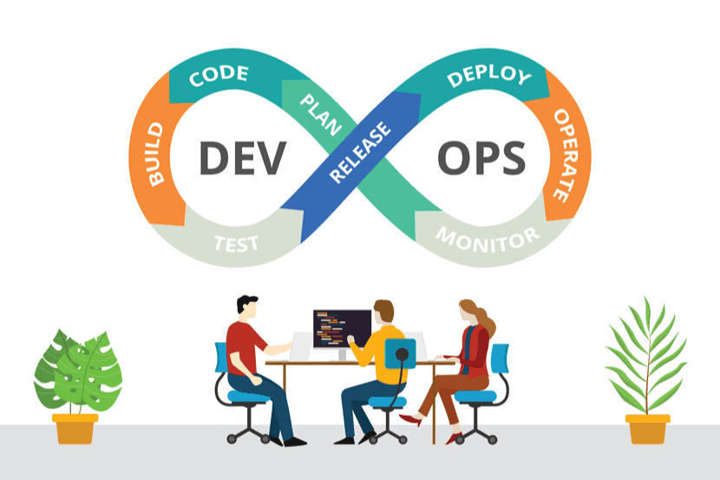
Diagram:
DevOps Automated Pipeline.

Slide 19
Problems Faced by Companies Not Adopting Modern Methodologies
Slow Release Cycles: Products may take months to launch.
Inability to Respond to Change: Struggles to pivot based on market demand.
Increased Costs: Fixing issues later in the project becomes costly.
Solution:
Agile: Respond quickly with incremental updates.
DevOps: Automate processes for faster, more reliable deployments.

Slide 20
Example:
Blockbuster: Failed to adapt to online streaming, which led to Netflix overtaking the movie rental market.
Kodak: Stuck to traditional film photography and didn't switch to digital fast enough, losing its market leadership.
Nokia: Continued using old development methods and was slow to innovate with smartphones, losing to Apple and Android.
BlackBerry: Relied on outdated mobile technologies and didn't embrace touchscreens, leading to a decline in popularity.
Borders: Focused on physical bookstores and was slow to embrace e-books and online sales, which caused its closure.

Slide 21
Companies Succeeding with Agile & DevOps
COMPANY | METHADOLOGY | IMPACT
Netflix | DevOps | Enables seamless streaming updates and rapid bug fixes.
Google | Agile | Facilitates continuous innovation and quick feature releases.
Spotify | Agile | Delivers frequent updates based on real-time user feedback.
Facebook | Agile & DevOps | Rolls out multiple updates daily, ensuring fast iterations and rapid feedback incorporation.
Netflix, Spotify, Google, Amazon, and many more.

Slide 22
Conclusion : The Future with Agile & DevOps
Modern software development methods like Agile and DevOps are necessary for faster time-to-market, better quality, and continuous improvement.
Companies that embrace these approaches can better adapt to customer needs and stay competitive in the fast-paced digital world.

Slide 23
FAQs: Why Adopt Modern Technologies?
Q1: Why can’t we stick to traditional methods?
Answer: Traditional methods are too slow for today’s fast-moving
tech landscape, where companies need to deliver software rapidly.
Q2: How does Agile help us deliver faster?
Answer: Agile breaks projects into small, manageable sprints,
allowing teams to focus on specific tasks and deliver increments
faster.
Q3: Why is automation in DevOps so important?
Answer: Automation ensures faster, more reliable
deployments, reducing human error and allowing teams to
focus on innovation.

Slide 24
THANK YOU

